Slide 1
Lecture # 14
Finite Automata with output
Moore Machine
Examples of Moore machine

Slide 2
Finite Automaton with output
Finite automaton discussed so far, is just associated with the RE or the language.
There is a question whether does there exist an FA which generates an output string corresponding to each input string ?
The answer is yes. Such machines are called machines with output.
There are two types of machines with output.
  Moore machine and
  Mealy machine

Slide 3
Moore machine
A Moore machine consists of the following
A finite set of states q0, q1, q2, … where q0 is the initial state.
An alphabet of letters Σ = {a,b,c,…} from which the input strings are formed.
An alphabet Γ={x,y,z,…} of output characters from which output strings are generated.
A transition table that shows for each state and each input letter what state is entered the next.
An output table that shows what character is printed by each state as it is entered.

Slide 4
Note
It is to be noted that since in Moore machine no state is designated to be a final state, so there is no question of accepting any language by Moore machine.
However in some cases the relation between an input string and the corresponding output string may be identified by the Moore machine.
Moreover, the state to be initial is not important as if the machine is used several times and is restarted after some time, the machine will be started from the state where it was left off.

Slide 5
Example
Consider the following Moore machine having the states q0, q1, q2, q3 where q0 is the start state and
Σ = {a,b},
Γ={0,1}
The transition table follows as
Old States | New states after reading |  | Characters to be printed
 | a | b
q0 - | q1 | q3 | 1
q1 | q3 | q1 | 0
q2 | q0 | q3 | 0
q3 | q3 | q2 | 1

Slide 6
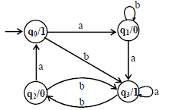
The transition diagram corresponding to the previous transition table may be
It is to be noted that the states are labeled along with the characters to be printed. Running the string abbabbba over the above machine, the corresponding output string will be 100010101, which can be determined by the following table as well

Slide 7
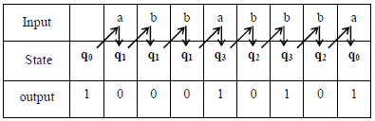
It is to be noted that the states are labeled along with the characters to be printed. Running the string abbabbba over the above machine, the corresponding output string will be 100010101, which can be determined by the following table as well
It may be noted that the length of output string is l more than that of input string as the initial state prints out the extra character 1, before the input string is read.

Slide 8
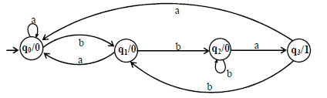
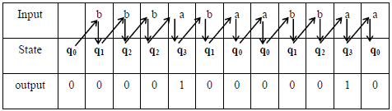
Example
To identify the relation between the input strings and the corresponding output strings in the following Moore machine,
if the string bbbabaabbaa is run, the output string will be 000010000010, as shown below

Slide 9
It can be observed from the given Moore machine that q3 is the only state which prints out the character 1 which shows that the moment the state q3 is entered, the machine will print out 1.
To enter the state q3, starting from q0 the string must contain bba. It can also be observed that to enter the state q3 once more the string must contain another substirng bba.
In general the input string will visit the state q3 as many times as the number of substringbba occurs in the input string.
Thus the number of 1’s in an output string will be same as the number of substring bba occurs in the corresponding input string

